Slide 1
Hypothesis Tests

Slide 2
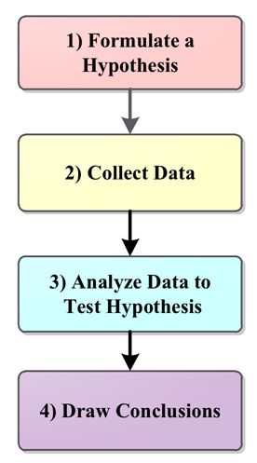
Hypothesis
Hypothesis is a claim that we want to investigate.
A hypothesis is used in an experiment to define the relationship between two variables.
Examples
If I replace the battery in my car, then my car will get better gas mileage.
If I eat more vegetables, then I will lose weight faster.
If I add fertilizer to my garden, then my plants will grow faster.
If I brush my teeth every day, then I will not develop cavities.
If I take my vitamins every day, then I will not feel tired.
If 50 mL of water are added to my plants each day and they grow, then adding 100 mL of water each day will make them grow even more.

Slide 3
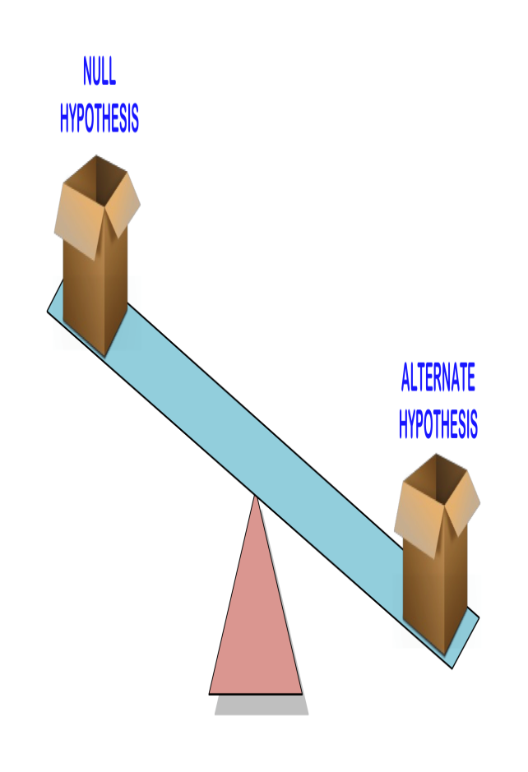
Hypothesis
Null Hypothesis:
This is the status quo
A null hypothesis is a hypothesis that says there is no statistical significance between the two variables.
It is usually the hypothesis a researcher will try to disprove.
Always contains the ‘=’ sign
Alternative Hypothesis:
Analternative hypothesis is one that states there is a statistically significant relationship between two variables.
The alternate hypothesis is simply the opposite of the null hypothesis
Is generally the hypothesis that is believed to be true by the researcher
Never contains just the ‘=’ sign

Slide 4
Hypothesis: Example
We want to compare the means of two variables
Lets say the average income of male and female
Null Hypothesis (H_{A}):
There is no difference between the groups .
Avg_income_{M} =Avg_income_{F}
Alternative Hypothesis (H_{A} ):
The average income of males does not equal the average income of females.
Avg_income_{M} ≠ Avg_income_{F}

Slide 5
Hypothesis: Example
A candy machine makes chocolate bars that are on average of 5g.
The worker is claiming that after maintenance, the machine no longer makes bars of 5g.
Write H 0 and H 1 .
H 0 : µ = 5g
H a : µ ≠ 5g
Possible outcomes of a hypothesis:
• Reject the Null hypothesis
• Fail to reject the Null Hypothesis

Slide 6
Hypothesis: Example
P-value: is the probability of ocurrance of a given event.
Assuming a confidence interval is 95%, if p-value < α, then we reject the Null Hypothesis in favor of the Alternative Hypothesis.
If p <= alpha : Reject H0
If p > alpha : Failed to Reject H0

Slide 7
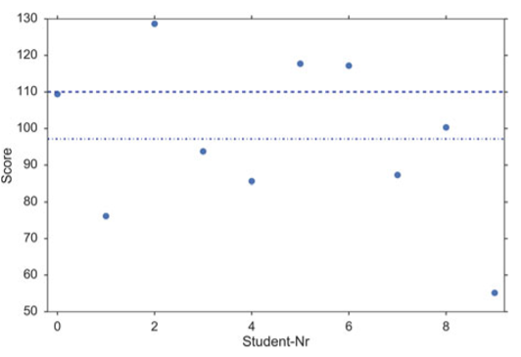
Hypothesis Concept Example
Assume that you are running a private educational institution.
The national average score is 100.
If your students score 110 in the ﬁnal exam, you get a bonus.
When the results are signiﬁcantly lower, you loose your bonus (because the students are not good enough), and you have to hire more teachers;
When the results are signiﬁcantly higher, you also loose your bonus (because you have spent too much money on teachers), and you have to cut back on the number of teachers.
The ﬁnal exam of your ten students producethe following scores:
109.4, 76.2, 128.7, 93.7, 85.6, 117.7, 117.2, 87.3, 100.3, 55.1

Slide 8
Hypothesis Concept Example
The ﬁnal exam of your ten students produce the following scores:
109.4, 76.2, 128.7, 93.7, 85.6, 117.7, 117.2, 87.3, 100.3, 55.1
sample mean (dashed-dotted line) and the observed variance of the data (the sample variance)
The population mean is 110 (dashed line)
Question: Is the mean value of the scores (97.1) signiﬁcantly different from 110?
Null hypothesis: The difference between the population mean and 110 is zero.
Can we keep our null hypothesis, or do we have to reject it based on the data?

Slide 9
Hypothesis Concept Example
A normality test on the data (stats.normaltest(scores)) indicates that the data are probably taken from a normal distribution.
Since we don’t know the population variance of the results of students tested, we have to take our best guess, the sample variance.
We know that the normalized difference between sample and the population mean, the t-statistic, follows the t-distribution.
The difference between our sample mean and the value we want to compare it to ( np.mean(scores) - 110 ) is–12.9.
Normalized by the sample standard error, this gives a value of t =-1.84.
Since the t-distribution is a known curve that depends only on the number of samples, and we can calculate the likelihood that we obtain a t-statistic of |t| > 1:84
tval = (110-np.mean(scores))/stats.sem(scores) # 1.84
td = stats.t(len(scores)-1) # "frozen" t-distribution
p = 2*td.sf(tval) # 0.0995
Expressed in words, given our sample data, we can state that the likelihood that the population mean is 110 is 9.95%.
If the likelihood is less than 5%, we conclude that the observed value of 97.1 is not signiﬁcantly different from 110, and the bonus has to be paid out.

Slide 10
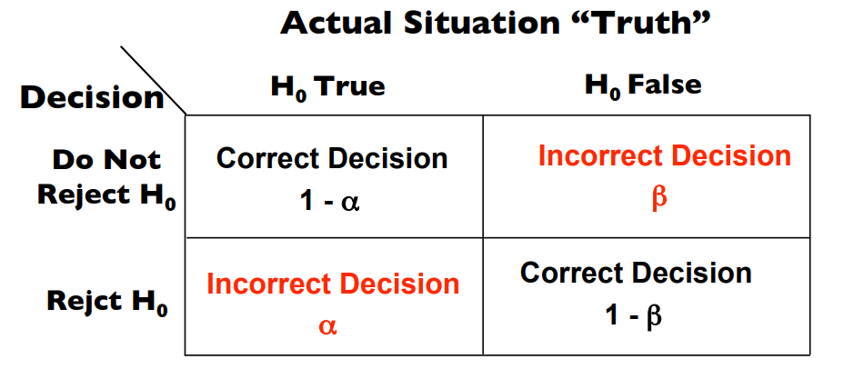
Errors in hypothesis tests

Slide 11
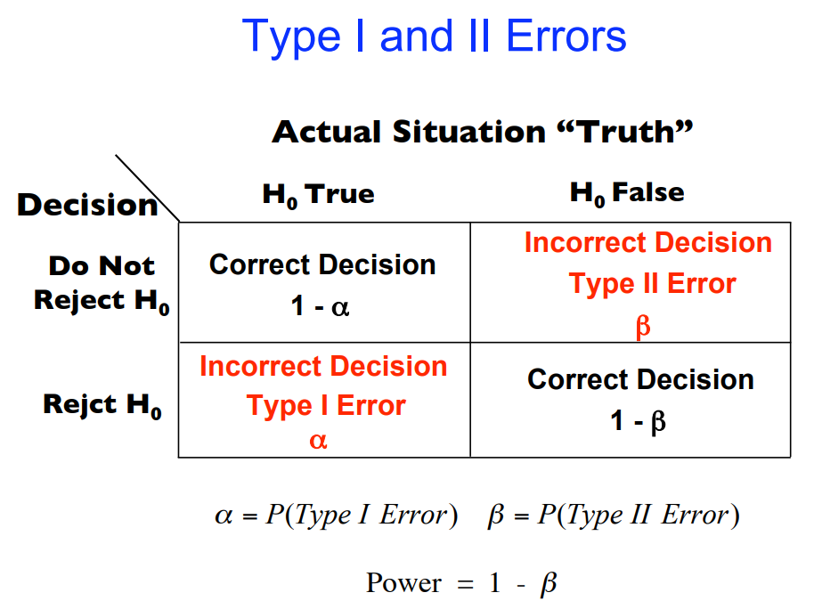

Slide 12
Tests of Means of Numerical Data
Hypothesis tests for the mean values of groups
Comparison of one group with a ﬁxed value.
Comparison of two groups with respect to each other.
Comparison of three or more groups with each other

Slide 13
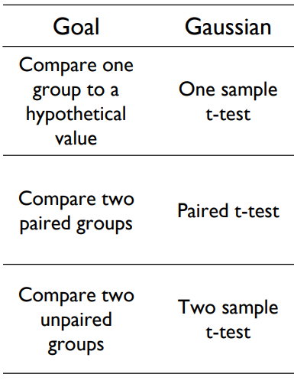
One and two sample tests
A one sample t-test is used to compare the mean of a sample to a known value (often 0, but not always).
A two sample t test is used to compare the means of two different samples.

Slide 14
One Sample t Test
Determines whether the sample mean is statistically different from a known or hypothesized population mean.
The One Sample t Test is a parametric test.
This test is also known as:
Single Sample t Test
The variable used in this test is known as:
Test variable
In a One Sample t Test, the test variable is compared against a "test value", which is a known or hypothesized value of the mean in the population.
H₀ and H₁ of the one sample T test can be expressed as:
H₀: µ = x ("the sample mean is equal to the [proposed] population mean") H₁: µ ≠ x ("the sample mean is not equal to the [proposed] population mean")
where µ is a constant proposed for the population mean and x is the sample mean.

Slide 15
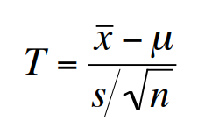
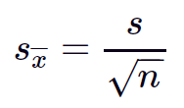
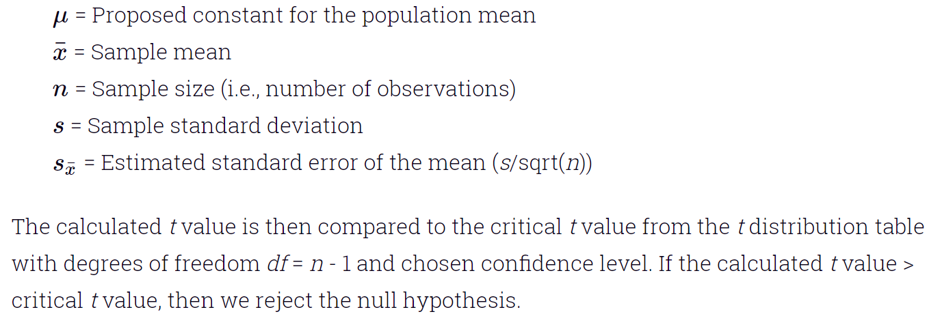
One Sample t Test: Test statistic
The test statistic for a One Sample t Test is denoted t, which is calculated using the following formula:

Slide 16
Python: one sample t-test
import numpy as np
from scipy.stats import norm
from scipy import stats
np.random.seed(7)
x1=norm.rvs(loc=0,scale=1,size=100)
m=0 #check value or constant
results = stats.ttest_1samp(x1, m)
print(results)
Ttest_1sampResult(statistic=0.11784116818175697, pvalue=0.9064322657112877)

Slide 17
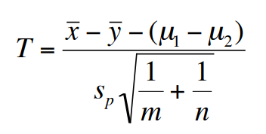
two Sample t Test: Test statistic
The test statistic for two Sample t Test is denoted t, which is calculated using the following formula:

Slide 18
Python: two sample t-test
import numpy as np
from scipy.stats import norm
from scipy import stats
np.random.seed(7)
x1=norm.rvs(loc=0,scale=1,size=100)
x2=norm.rvs(loc=0,scale=1,size=100)
stats.ttest_ind(x1,x2)
Result:
test_indResult(statistic=0.5691860234273843, pvalue=0.5698750154420147)

Slide 19
Python: paired t-test
Used to compare two population means where you have two samples in which observations in one sample can be paired with observations in the other sample. Procedure for carrying out a paired t-test
Examples:
Observations on students’ test results before and after a particular course.

Slide 20
Procedure for carrying out a paired t-test
Suppose a sample of n students were given a test before studying a particular module and then again after completing the module.
We want to find out if, in general, our teaching leads to improvements in students’ knowledge/skills (i.e. test scores).
We can use the results from our sample of students to draw conclusions about the impact of this module in general.

Slide 21
Procedure for carrying out a paired t-test
Suppose a sample of n students were given a test before studying a particular module and then again after completing the module.
We want to find out if, in general, our teaching leads to improvements in students’ knowledge/skills (i.e. test scores).
We can use the results from our sample of students to draw conclusions about the impact of this module in general.

Slide 22
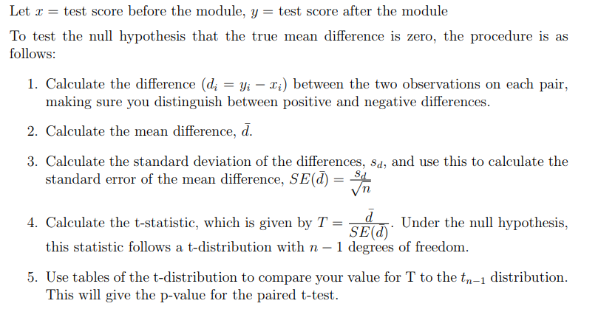
Procedure for carrying out a paired t-test

Slide 23
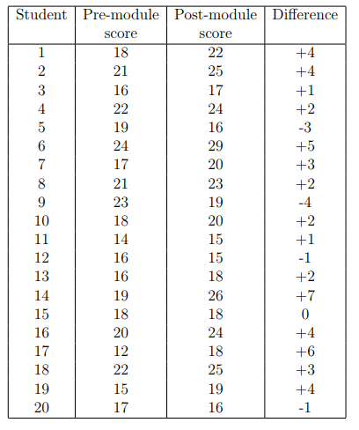
Example for carrying out a paired t-test

Slide 24
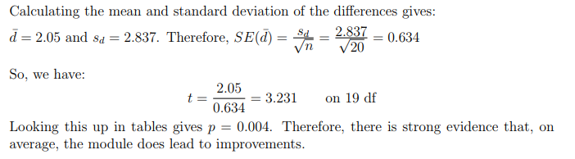
Example for carrying out a paired t-test

Slide 25
Python code: paired t-test
import pandas as pd
from scipy.stats import ttest_rel
df = pd.read_csv("blood_pressure.csv")
df[['bp_before','bp_after']].describe()
df['bp_difference'] = df['bp_before'] - df['bp_after']
stats.ttest_rel(df['bp_before'], df['bp_after'])

Slide 26
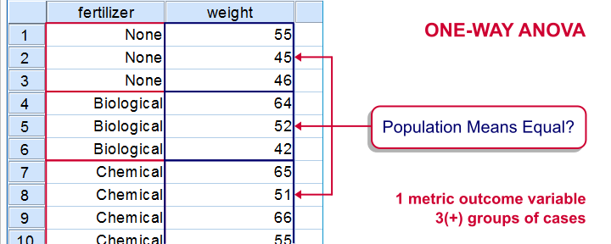
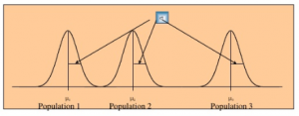
ANOVA
ANOVA -short for “analysis of variance”- is a statistical technique for testing if 3(+) population means are all equal.

Slide 27
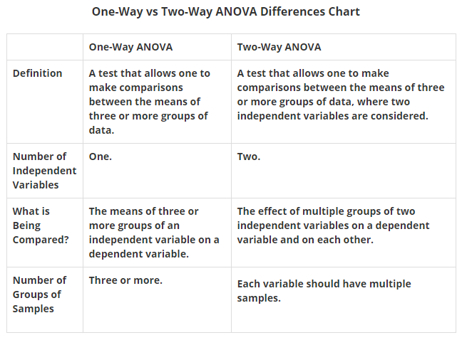
Types of ANOVA

Slide 28
Steps in ANOVA
State the null and alternative hypotheses
Calculate the appropriate test statistic
Obtain the Critical Value
Decision Rule

Slide 29
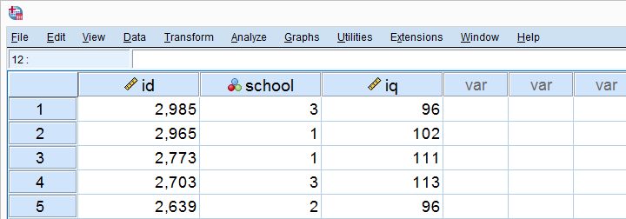
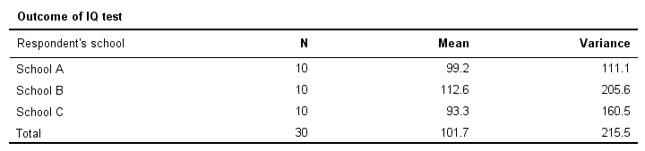
Simple Example - One-Way ANOVA
A scientist wants to know if all children from schools A, B and C have equal mean IQ scores. Each school has 1,000 children. It takes too much time and money to test all 3,000 children.
So a simple random sample of n = 10 children from each school is tested.

Slide 30
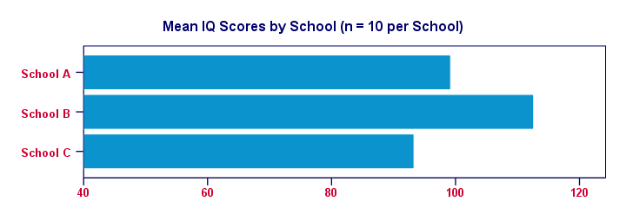
Simple Example - One-Way ANOVA
our sample from school B has the highest mean IQ - roughly 113 points.
The lowest mean IQ -some 93 points- is seen for school C.
Now, here's the problem: our mean IQ scores are only based on tiny samples of 10 children per school.
So couldn't it be that all 1,000 children per school have the same mean IQ?

Slide 31
Simple Example - One-Way ANOVA
ANOVA - Hypothesis
Null Hypothesis:
all population means are exactly equal.
Alternate Hypothesis:
all population means are not equal.

Slide 32
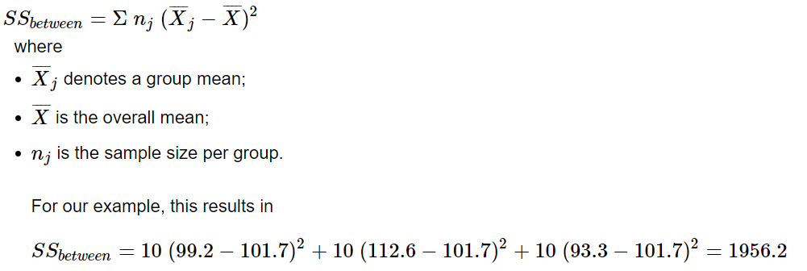
Simple Example - One-Way ANOVA
ANOVA - Sums of Squares Between
Sum of squares between expresses the total amount of dispersion among the sample means.

Slide 33
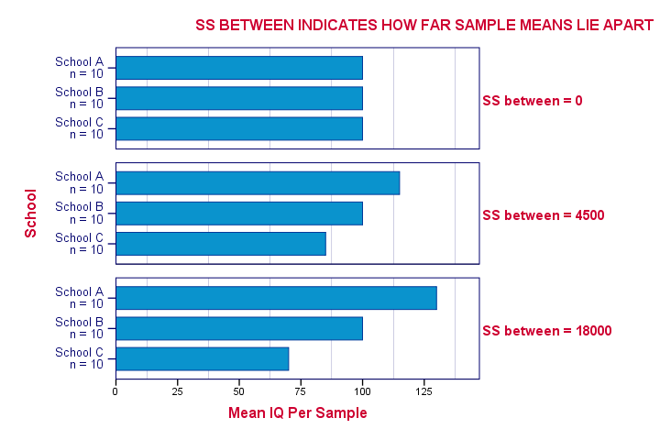
Simple Example - One-Way ANOVA
Larger SSbetween indicates that the sample means differ more.
And the more different our sample means, the more likely that our population means differ as well.

Slide 34
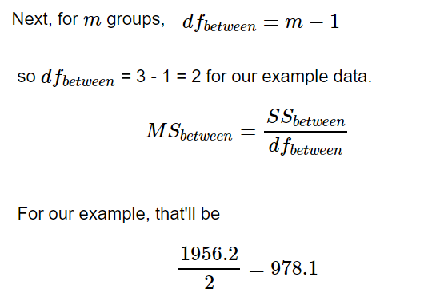
Simple Example - One-Way ANOVA
mean squares between is basically the variance among sample means.

Slide 35
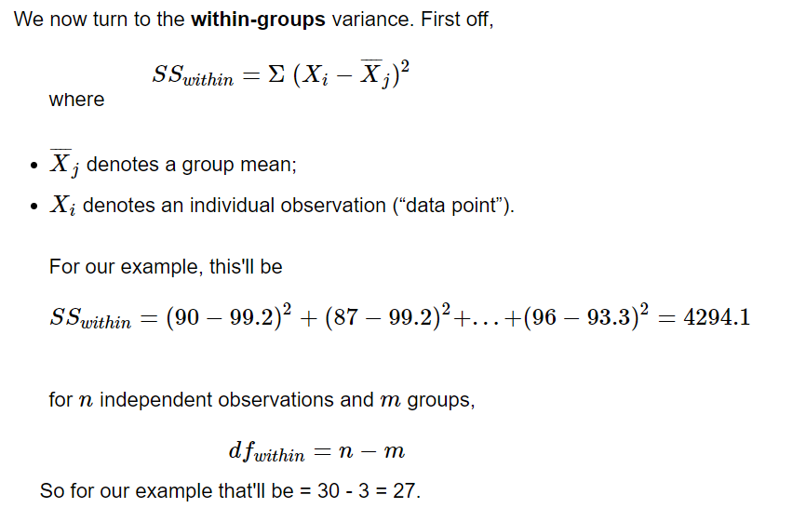
Simple Example - One-Way ANOVA
ANOVA - Sums of Squares Within

Slide 36
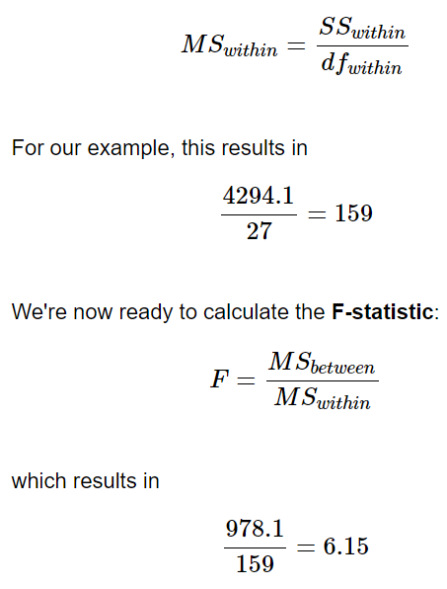
Simple Example - One-Way ANOVA
ANOVA - Sums of Squares Within

Slide 37
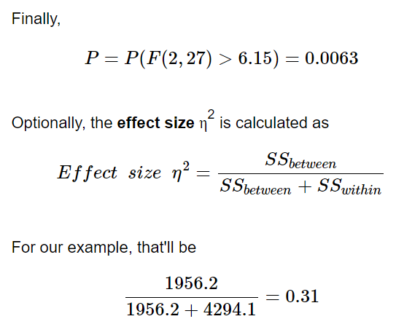
Simple Example - One-Way ANOVA
ANOVA - Sums of Squares Within

Slide 38
ANOVA - Assumptions
Observations in each sample are independent and identically distributed (iid).
Observations in each sample are normally distributed.
Observations in each sample have the same variance.

Slide 39
Python Code: ANOVA
 | from scipy.stats import f_oneway data1, data2, ... = ... stat, p = f_oneway(data1, data2, ...)

Slide 40
Two- way ANOVA
When the outcome or dependent variable (in our case the test scores) is affected by two independent variables/factors we use two-way ANOVA.

Slide 41
Two- way ANOVA : Example
H0: All the music treatment groups have equal mean score
H1: Music does not have an effect
H0: All the age groups have equal mean score.
H2: Age does not have an effect
H0: The factors are independent or the interaction effect does not exist.
H3: Both music and age have an impact on treatment

Slide 42
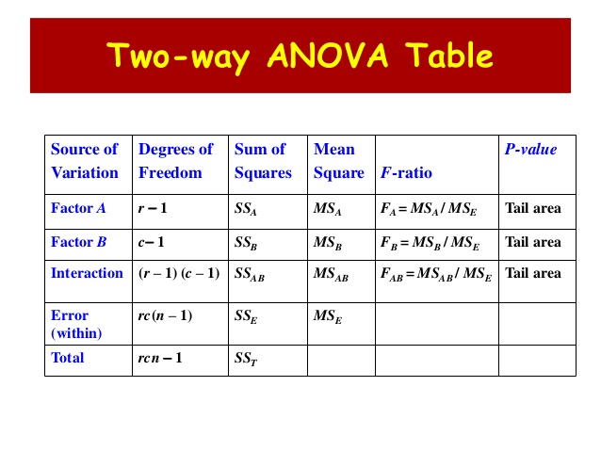

Slide 43
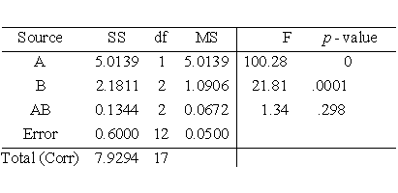

Slide 44
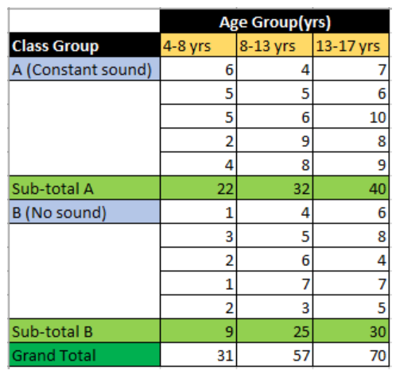
Two- way ANOVA : Example

Slide 45
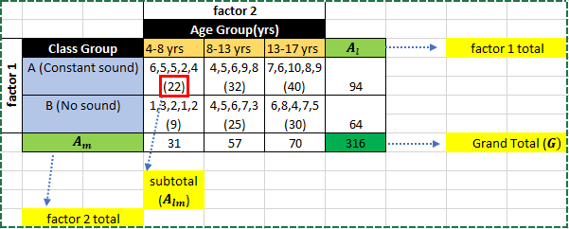
Two- way ANOVA : Example

Slide 46
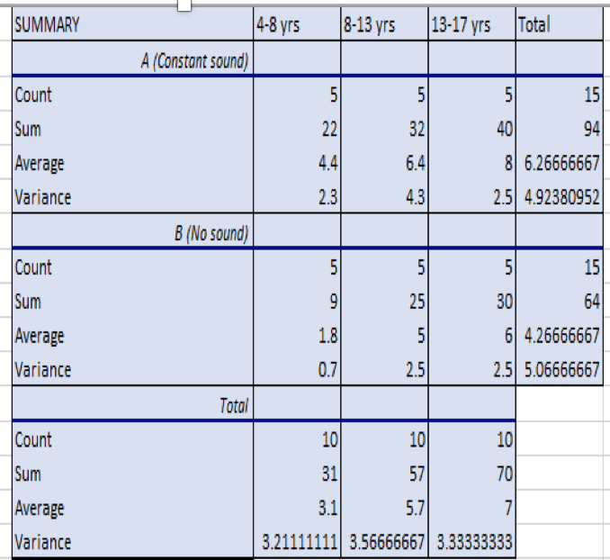
Two- way ANOVA : Example

Slide 47
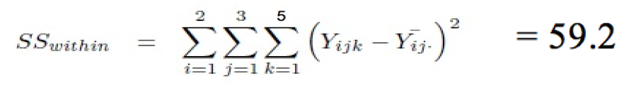






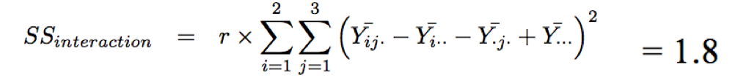
Two- way ANOVA : Example

Slide 48


Two- way ANOVA : Example

Slide 49
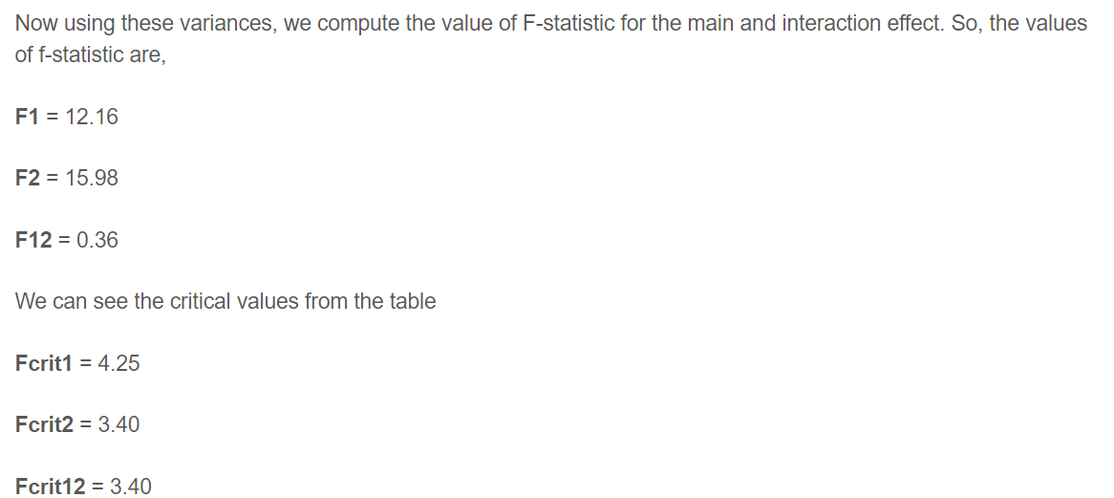

Slide 50
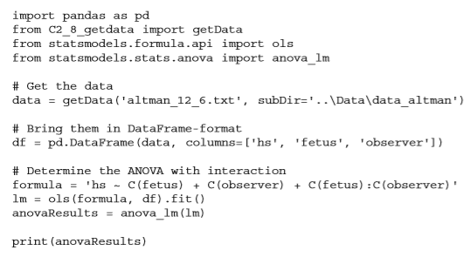
Two-way ANOVA: Python code

Slide 51
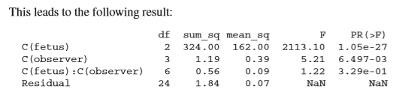
Two-way ANOVA: Python code

